Slide 1














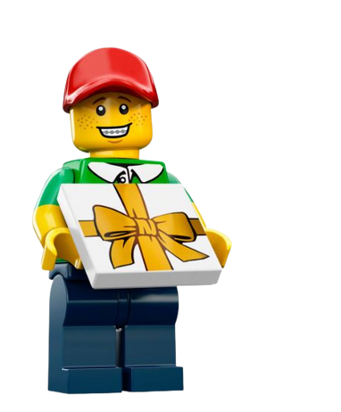





LEGOLAND Discovery Centre
®
CONGRATULATIONS
Voor/to:
Name
Van/from:
Name
Write your personal message
conditions:
This is not an entrance ticket. Don't forget to include the original ticket with
the barcode on your visit.
The Gift voucher cannot be exchanged for money and is not valid in the LEGO Store
The Gift voucher is only valid in combination with a time slot. Book your
time slot via: www.LEGOLANDDiscoverycentre.com/Scheveningen/gift-voucher

